Slide 1
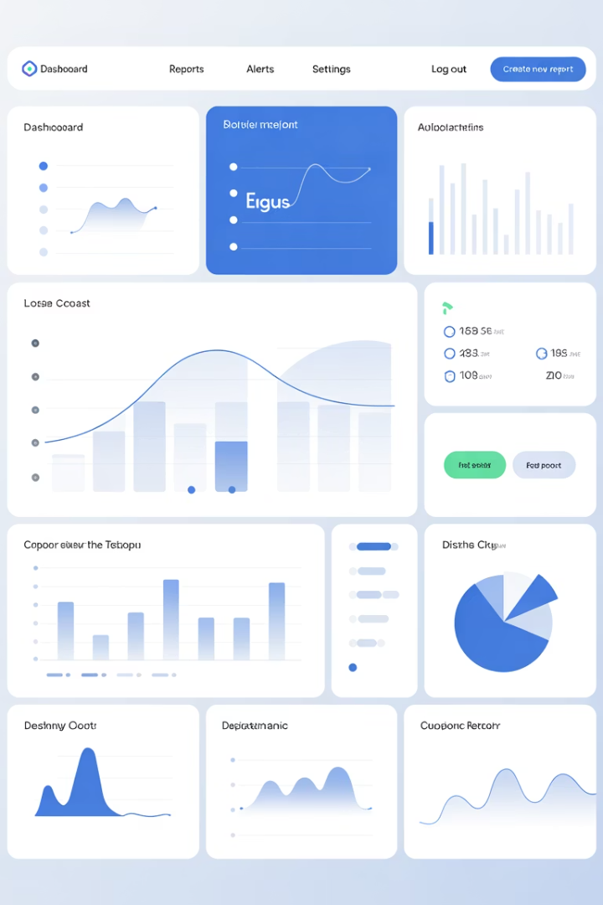
Data Audit Report Analysis
Understanding your data migration audit results. Key findings and actionable recommendations for system improvement.

Slide 2

Record Count Overview
4
4
Old System Records
New CRM Records
Total customer records
Successfully migrated
100%
Migration Rate
All records transferred
Both systems contain identical record counts. Migration preserved total customer numbers successfully.

Slide 3
Missing Values Analysis
Old System
New CRM
Email field missing for Bob Johnson. One incomplete customer record identified.
Phone field missing for Jane Smith. Different field affected post-migration.
Missing values shifted between systems. Data completeness requires attention in both platforms.

Slide 4

Critical Field Discrepancies
Jane Smith (ID 102)
Alice Brown (ID 104)
Phone number lost during migration process.
Name and email completely missing in new system.
Mike Davis (ID 105)
New customer added with complete information.

Slide 5

Date Format Inconsistencies
Old System Format
New CRM Format
Uses ISO standard (YYYY-MM-DD) for consistent global compatibility.
Uses US format (MM/DD/YYYY) creating potential confusion.
Impact Risk
Date misinterpretation in reports and automated queries.

Slide 6




Data Quality Summary
Completeness
Accuracy
1
2
Missing values in both systems require attention.
Significant field discrepancies between systems detected.
Duplicates
Consistency
No duplicate records found in new CRM.
Date format standardization needed urgently.
4
3

Slide 7





Priority Recommendations
Fix Missing Values
Address Bob Johnson's email and Jane Smith's phone immediately.
Resolve Discrepancies
Investigate Alice Brown's missing data and verify Mike Davis addition.
Standardize Formats
Convert all dates to ISO format for consistency.
Enhance Validation
Implement automated checks for future migrations.

Slide 8

Next Steps Forward
Update Audit Report
Document all findings using provided template structure.
Address Critical Issues
Work with stakeholders to fix identified data problems.
Automate Future Audits
Implement reconciliation scripts for ongoing data quality monitoring.
Systematic approach ensures data integrity. Regular audits prevent future migration issues.

